Slide 1
Recommendations from the Offshore Wind Outlook for Gujarat and Tamil Nadu
ROHIT GADRE 8 March 2018

Slide 2
  INTRODUCTION
This report lays out the challenges, enablers and action items for development of offshore wind in Gujarat and Tamil Nadu.
The 5GW is NOT a best-case assessment and NOT a proposed target.
So what role does a number play?
Serves as indicative guidance
that focuses the attention
of policy makers and private industry
into developing India’s offshore wind sector
along with entire ancillary infra. and supply chain to scale
Notes:
Responsibilities at the national level are mirrored at the state level. Important to share a common vision, harmonize plans and coordinate on infrastructure development.

Slide 3
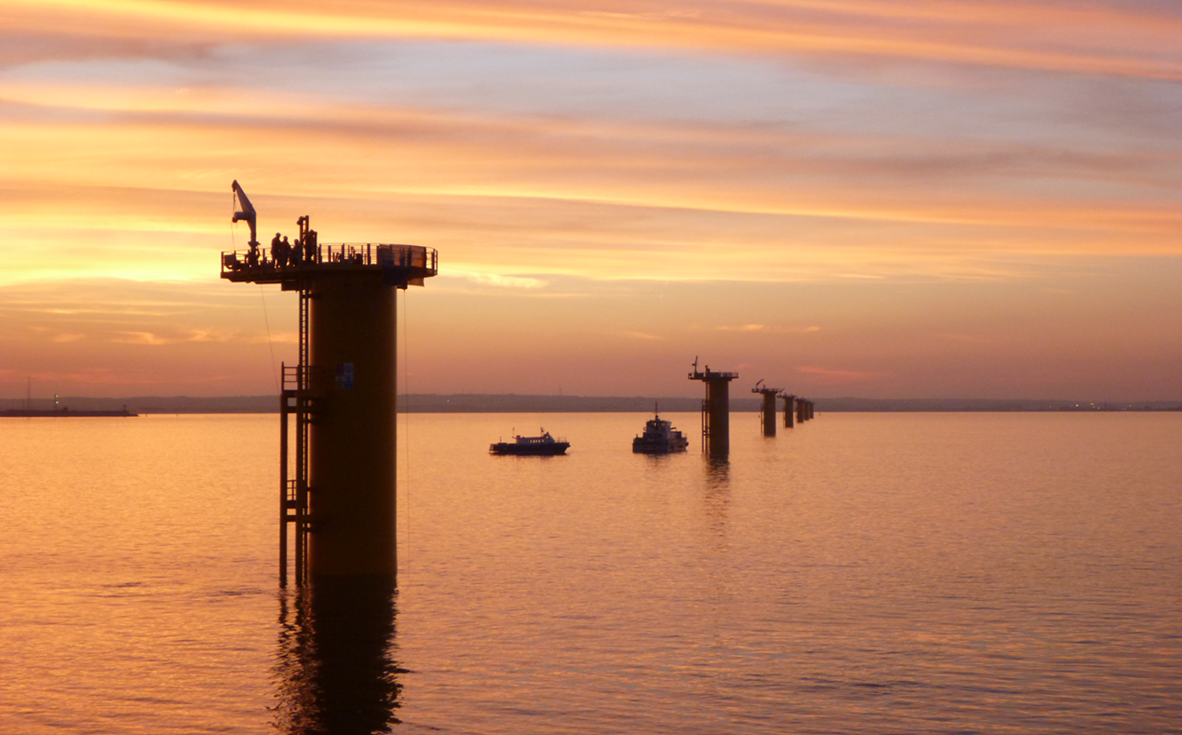
Challenges to the growth of offshore wind
Complex development process
Levelised Cost of Energy
Financing
Supply chain, port and grid infrastructure
Socio –environmental constraints

Slide 4
        Complex development process: Managing large number of stakeholders
Investors
Independent Engineer (IE)
Land Owners
Ports
(Construction and O&M)
Local Government
Nodal Agency
Project Developer
Utility
Regulatory/ Permitting
EIA
EPCI
Owner’s Engineer (OE)
Insurers
HSE
WTG
Foundation & Substructure
Installation/ Marine Operations
O&M
Electrical
WTG & Foundation Installer
Submarine Cable
Vessel
Marine Warranty Surveyor
In direct communication with Project Developer (e.g. Local Government, Owner’s Engineer, etc.)
Significant involvement in the Project and/or in consultation with Project Developer (e.g. WTG Suppliers)
Has no direct communications with Project Developer and required to inform it (e.g. Subcontractor of Main contractors)

Slide 5
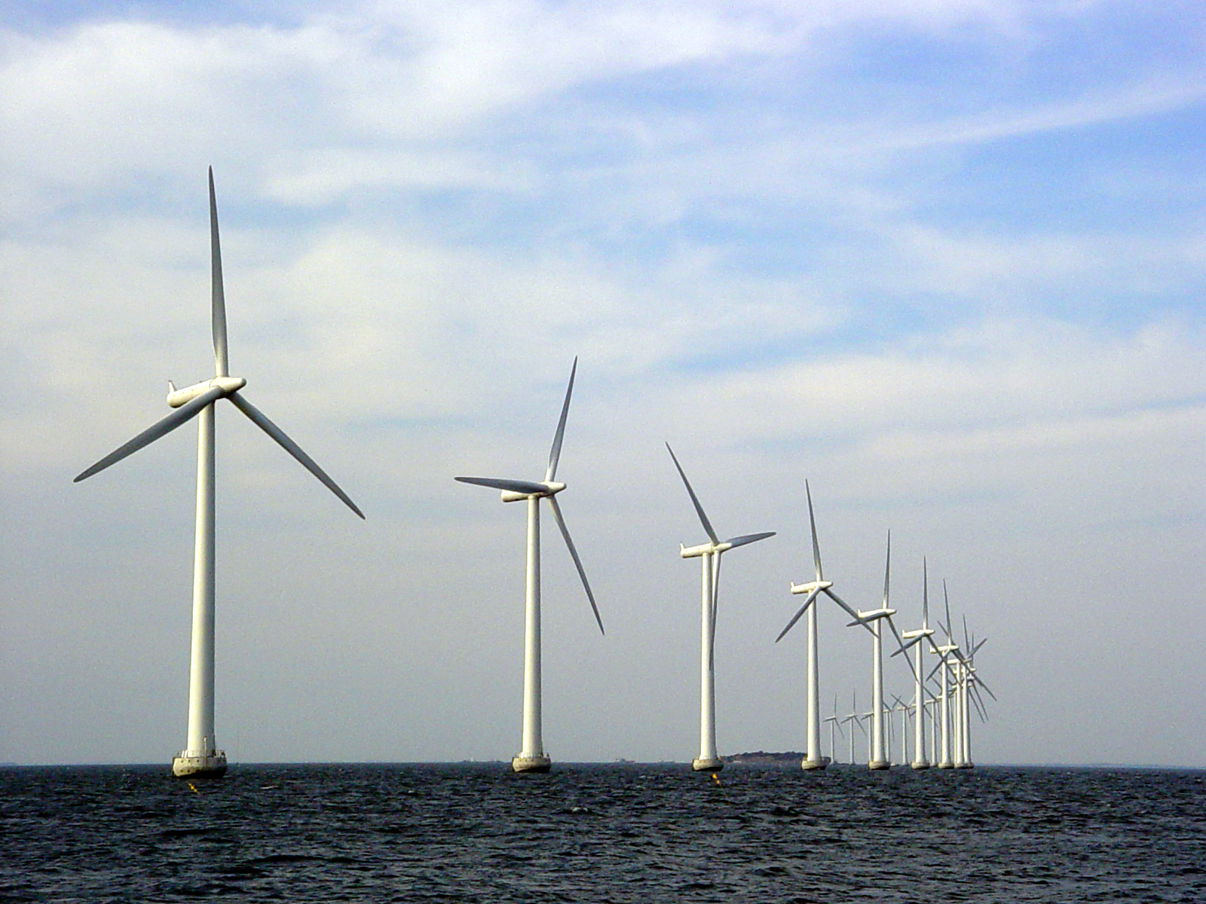
Enablers for the growth of offshore wind
De-risk development process
Maritime Spatial Planning
Demonstration Projects
Financial Support
Long-term vision

Slide 6
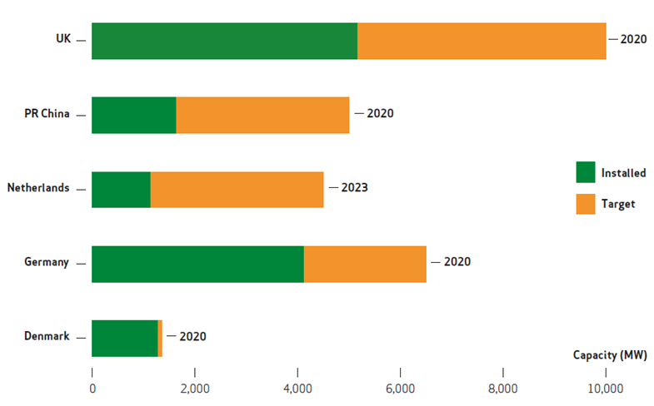
        Long-term vision
The EU 2020 National Renewable Energy Action Plans played a crucial role in catalysing industry activity, raising public awareness and attracting investors.
Many member states translated these into specific national goals for offshore wind looking at 2020 and beyond.
All major offshore wind markets today have national targets for renewable energy and specific plans for offshore wind development
Notes:
India has ambitious targets for the development of RE and there are strong local drivers to having a cleaner energy mix.

Slide 7
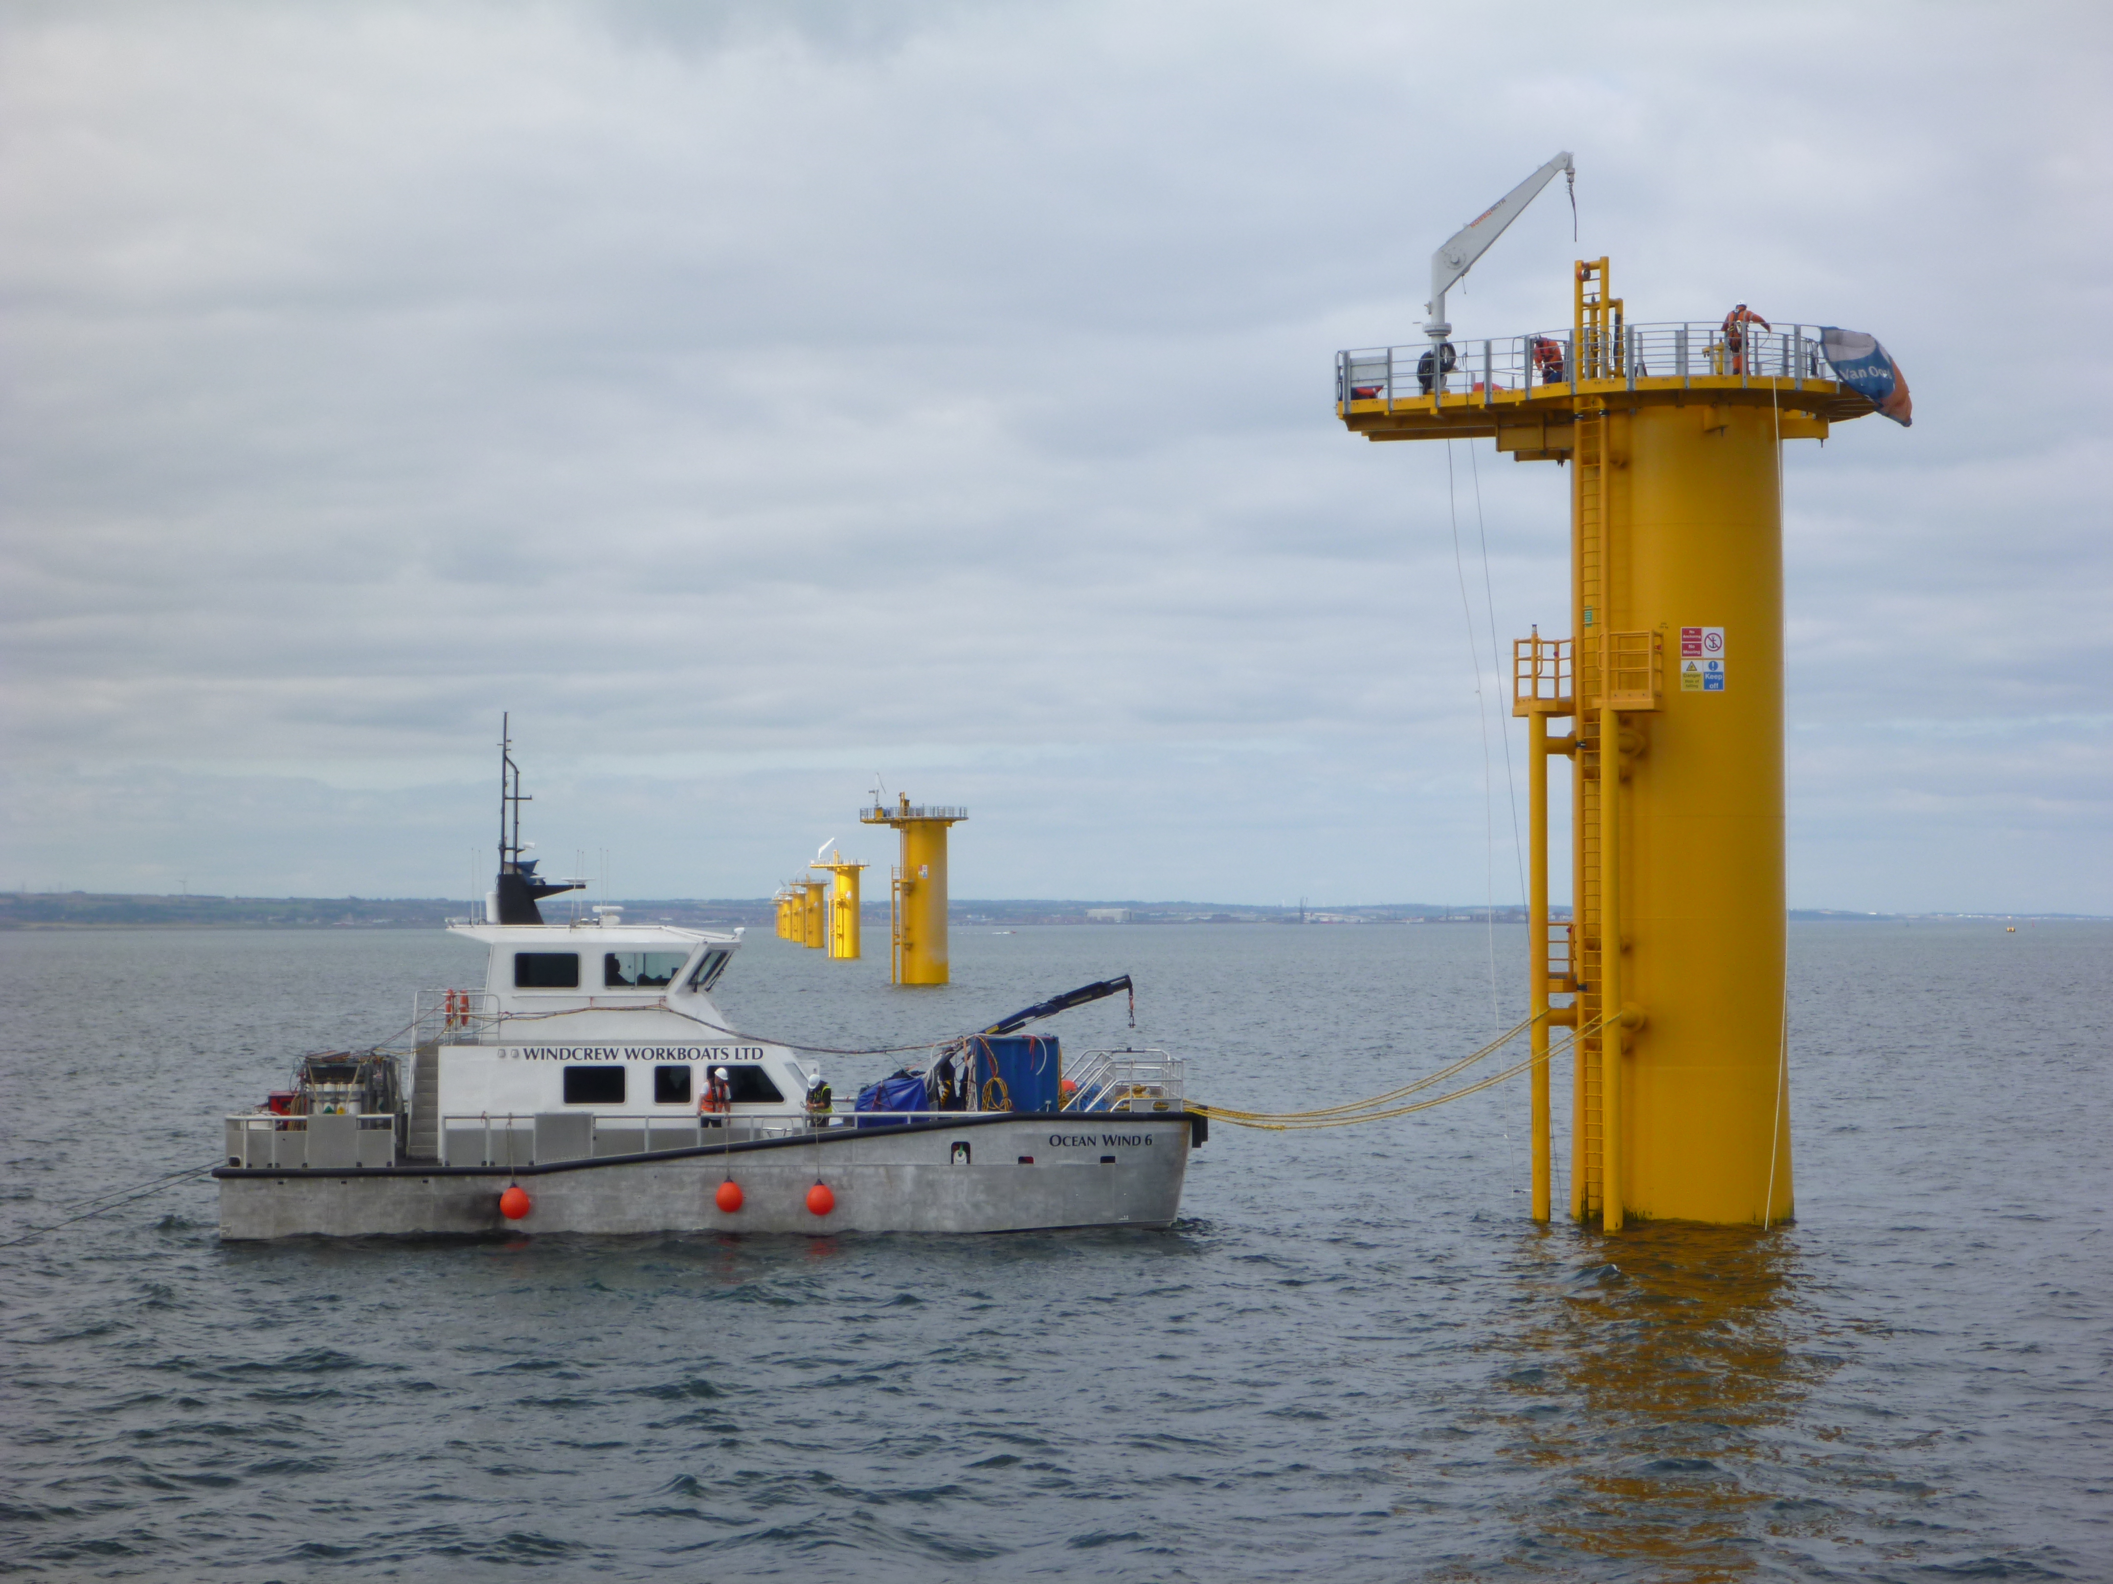
Actions to kick-start development
Clear roadmap
Consenting and permitting
Grid development
Financial support mechanisms
Competence and skill development

Slide 8
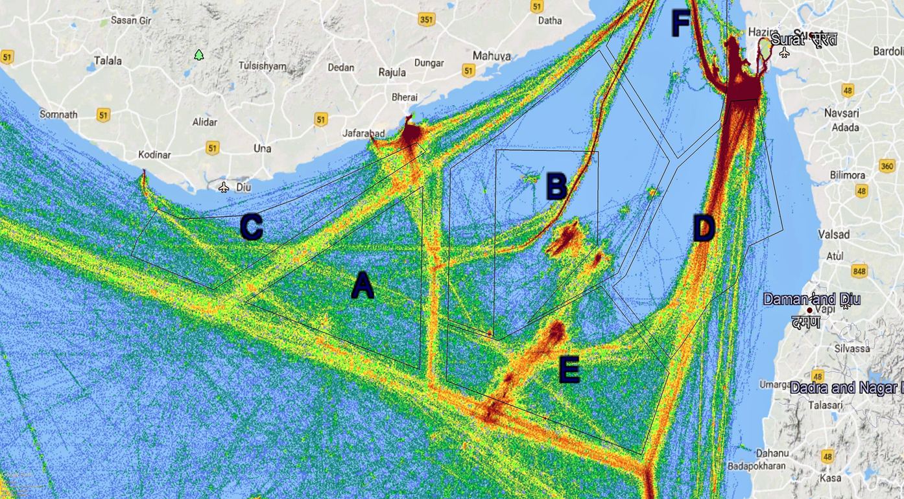
        Consenting and permitting: Managing competing maritime interests
Notes:
India has ambitious targets for the development of RE and there are strong local drivers to having a cleaner energy mix.

Slide 9
    Developing offshore wind in Gujarat and Tamil Nadu: 2018 - 2032
Short term
Medium term
Long term
Preliminary site studies, EIA for OWF sites
Set targets, roadmap
Government
Monitor of sector performance locally and global industry evolution
Policy on consenting and long term incentives
Grid planning and development, Inter-agency coordination, Financing
Nearshore projects
Private sector
Deepwater projects
Floating projects
Competence development, R&D investment, Global collaborations, Project Financing
Trends
Reduction in Levelised Cost of Energy
Increased investor confidence and public acceptance
Notes:
Onshore grid infrastructure must be ready for OWF connection and power evacuation

Slide 10
  Q&A?
  Open Discussion

Slide 11
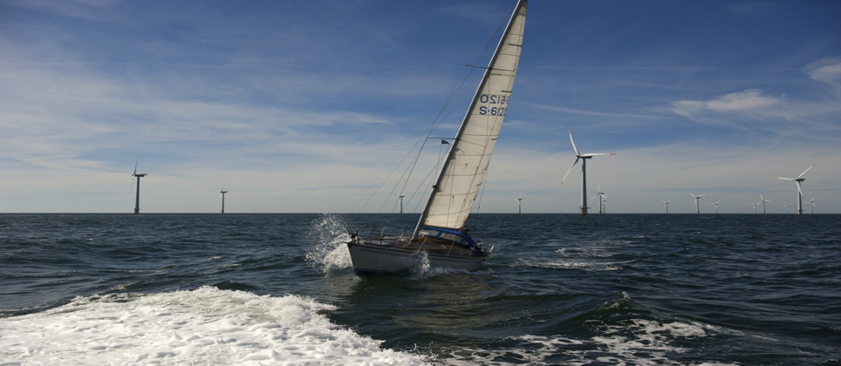
This project is co-funded by the European Union
For more information please contact:
FOWIND Project Management Unit, alok.kumar@dnvgl.com; shruti.shukla@gwec.net

