Slide 1
08 March 2018
PROJECT GRANTED UNDER INDO-EUROPEAN COOPERATION ON RENEWABLE ENERGY

Slide 2
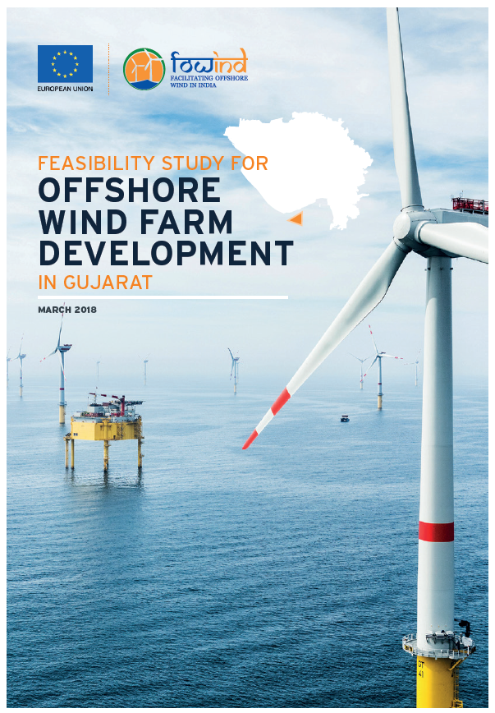

Gujarat and Tamil Nadu Full-feasibility Studies
The objective of these reports is to provide a concept design for a demonstration project of 150 to 500 MW in Gujarat’s and Tamil Nadu’s most promising offshore wind development areas, “zone A” identified in the 2015 Pre-feasibility studies.
Notes:
This provides companies and government institutions with a starting point for future detailed offshore Front End Engineering Design (FEED) studies and assists with the identification of key project risks

Slide 3
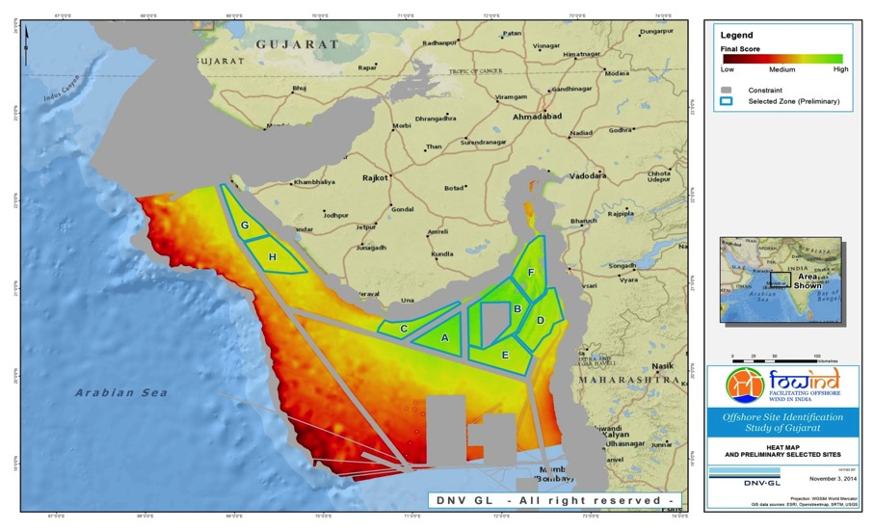
Offshore heat map potential Gujarat
Notes:
The potential zones, considered most suitable for offshore wind energy development, were identified by
pragmatically ranking their compliance with a set of defined technical and environmental parameters.
Such as wind resource, water depth, proximity to construction port, grid connection, etc.
The methodological approach is summarised in the following five main steps:
1. Mapping and identification of spatial constraints (e.g. environmental features, built features, wind
resource, transmission lines, etc.);
2. Removal of areas of constraint, defined as those which directly impact both the technical,
commercial and social-environmental feasibility of an offshore wind development;
3. Pragmatic weighting of the remaining area, outside the defined ‘hard’ constraints, to identify suitable
sites for wind farm development, taking into consideration the factors which impact the technical and
commercial feasibility of wind farm development;
4. Identification of the most promising sites (iterative process); and
5. Ranking, analysis and description of identified sites.
technical, financial, social and environmental parameters were considered to identify
eight potential zones
Wind Resource – to date no publically available on-site wind measurements have been recorded
within the Gujarat offshore zone;
• Zone Selection – eight zones have been identified with mean wind speeds in the range of 6.8 to 7.0
m/s (at 120 m AGL) and water depths in the range of 15 to 43 m below LAT;
• Turbine Selection – predicted extreme typhoon wind conditions meant Class I or S wind turbines
were taken forward for further investigation

Slide 4
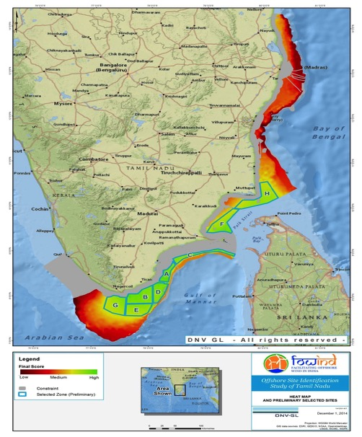
Offshore heat map potential – Tamil Nadu

Slide 5



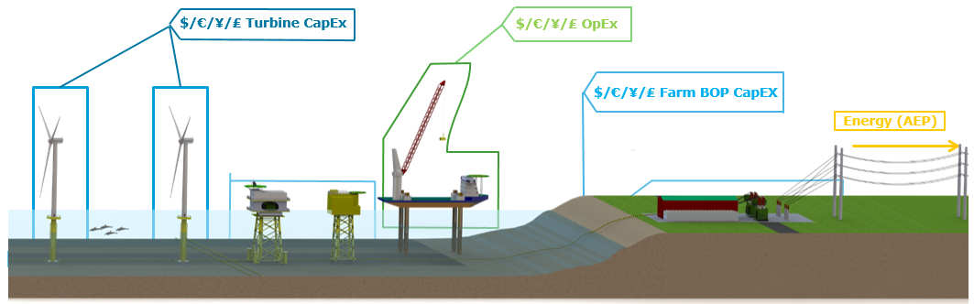
Full feasibility study scope of work
DEMONSTRATION WIND FARM LOCATION
SITE DATA STUDY (metocean and geotechnical)
TURBINE SELECTION STUDY
WINDFARM LAYOUT
ENERGY PRODUCTION
ELECTRICAL CONCEPT DESIGN
PRELIMINARY FOUNDATION COMPARISON
INSTALLATION AND LOGISTICS
OPERATION AND MAINTENANCE STUDY
OUTLINE PROJECT COSTING (LCOE)
OUTLINE PROJECT RISK REGISTER
ENVIRONMENTAL AND SOCIAL IMPACT
KEY FINDINGS AND RECOMMENDATIONS
Notes:
DNV GL’s integrated cost of energy modelling tool, Turbine.Architect is at the core of this full feasibility study.
• Spatial analysis and selection of the demonstration wind farm location;
• Concept design of representative 4 MW, 6 MW and 10 MW offshore wind turbine platforms;
• Estimation of electrical system CapEx
• Preliminary foundation concepts and CapEx estimates, monopiles and jackets
• Estimation of construction CapEx
• Demo project Levelised Cost of Energy (LCOE) estimates for multiple configurations of MW capacity (150 and 504 MW) and wind turbines (4, 6 and 10 MW).

Slide 6
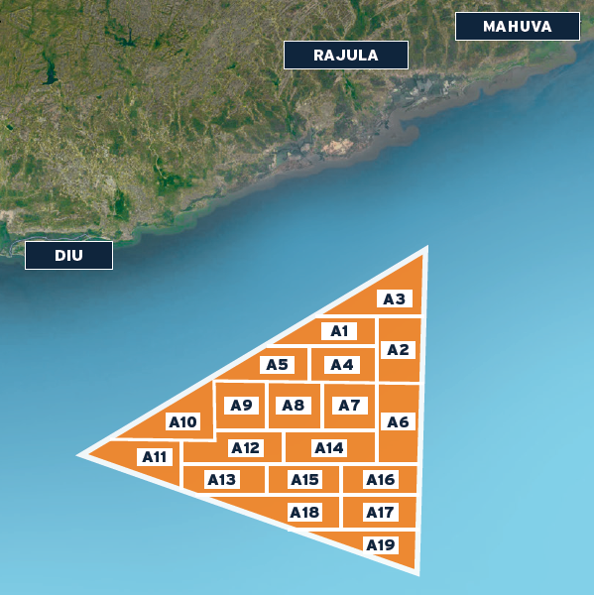
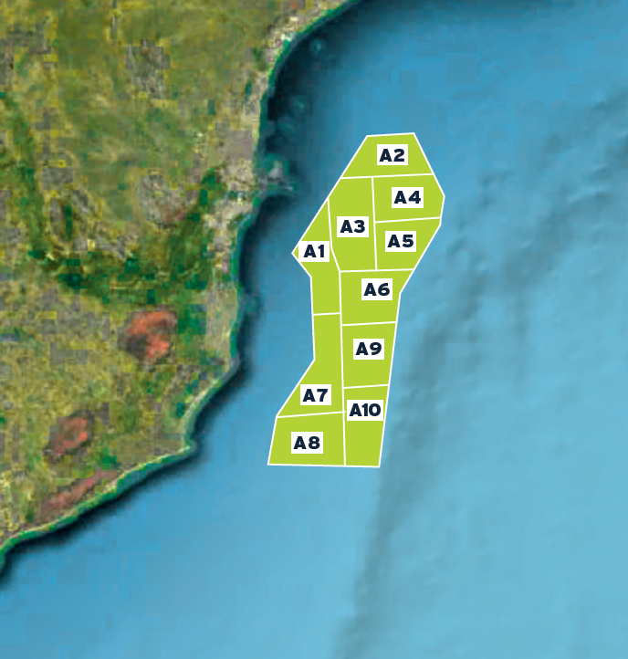
Demonstration Wind Farm Location
Gujarat – zone A, 19 sub-zones
Tamil Nadu – zone A, 10 sub-zones
-15.5 mLAT
6.99 m/s (at 120 m AGL)
25.3 km to coast
-18.1 mLAT
8.01 m/s (at 120 m AGL)
12.4 km to coast
Optimum LCOE zone = A3
lower CAPEX costs due to shallow
water depth and shorter distance to shore. Despite A3 having the lowest annual mean wind speed.
Optimum LCOE zone = A3
relatively close to shore and having a shallow water depth. A3 does not possess all the most favourable values in these properties out of all the sub-zones, but has the best combination of favourable values.
Notes:
19 sub-zones of similar area have been identified.

Slide 7
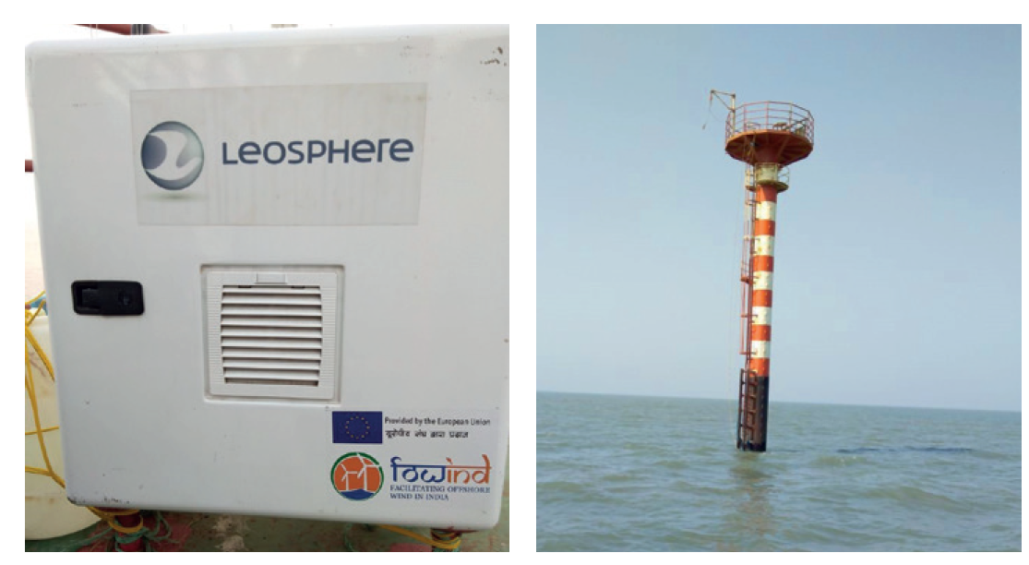
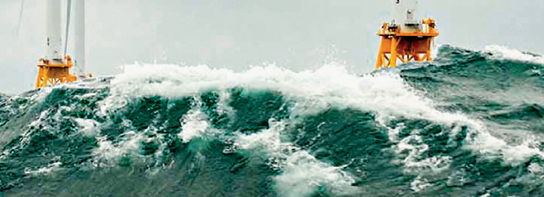
Site Conditions Study
Gujarat
Tamil Nadu
WIND RESOURCE:
FOWIND’s offshore LIDAR was commissioned on the 2nd of November 2017 and is collecting valuable on-site data
WAVE and CURRENTS:
a preliminary metocean study for zone A in Gujarat provides wave, current and tidal data suitable for concept design. 50-year typhoon induced waves are estimated at 12.5m Hmax and tidal currents at 2.2 m/s
GEOTECHNICAL CONDITIONS:
indicative lower/ upper bound soil profiles defined for zone A indicate extensive layers of weak clay persisting for 15 to 40m below seabed, before transitioning to competent sand. Upper clay layers exhibit limited strength both laterally and vertically
WIND RESOURCE:
currently there is no installed LIDAR in Tamil Nadu, NIWE have plans to commission a LIDAR in the Gulf of Mannar
WAVE and CURRENTS:
a preliminary metocean study for zone A in Tamil Nadu provides wave, current and tidal data suitable for concept design. 50-year typhoon induced waves are estimated at 11.0m Hmax and tidal currents at 1.3 m/s
GEOTECHNICAL CONDITIONS:
indicative lower/upper bound soil profiles defined for zone A indicate significant spatial variation in the southern Tamil Nadu offshore region; ranging from weak/loose sands/clays to strong cemented sand to depth. At the upper bound drivability would be a risk for piled foundations

Slide 8
Gujarat LiDAR Initial Data
Month | 123m agl (m/s) | 143m agl (m/s)
November 2017 | 6.62 | 6.79
December 2017 | 7.27 | 7.46
On the 2nd of November 2017, the FOWIND Consortium successful commissioned India’s first offshore LIDAR, off the coast of Gujarat.
Leosphere WINDCUBE v2
Approximately three months of raw measured data (Nov 17 to Jan 18) Appendix 3.
Typically a full energy assessment would require data coverage above 95% with a minimum of 12 months data.
Note that the typical annual trend of wind in the Gujarat region suggests stronger wind speeds in the summer period.

Slide 9
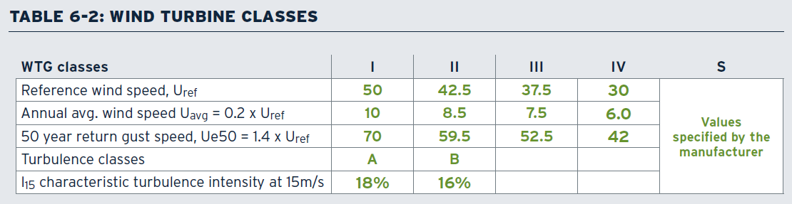
Turbine Selection Study
Predicted extreme typhoon wind conditions meant Class I or S wind turbines
Gujarat: IEC Class I turbines could be sufficient with 3-second gusts of 61.8 m/s and 63.4 m/s for hub-heights of 100 mMSL and 120mMSL respectively.
Tamil Nadu: IEC Class I turbines could be sufficient with 3-second gusts of 63.8 m/s and 65.4 m/s for hub-heights of 100 mMSL and 120mMSL respectively
Offshore wind turbines with a significant operating track record are still few and far between - significant mergers and joint ventures between the big players
Future “1x MW” turbine platforms with MW capacities exceeding 10 MW and with rotor diameters more than 200 m

Slide 10
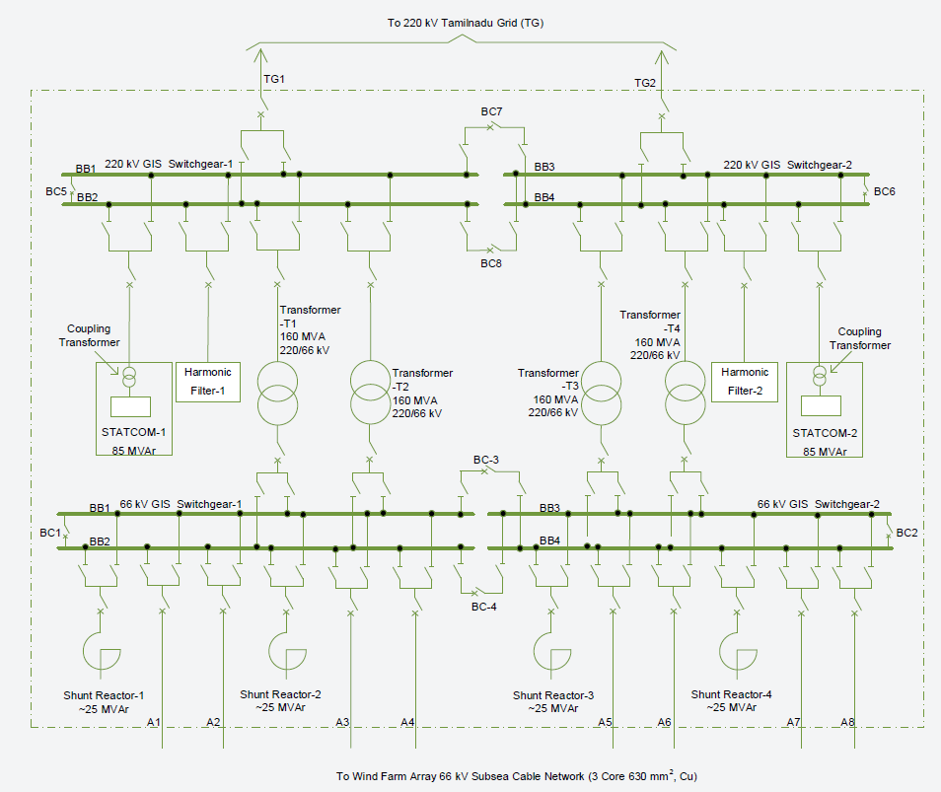
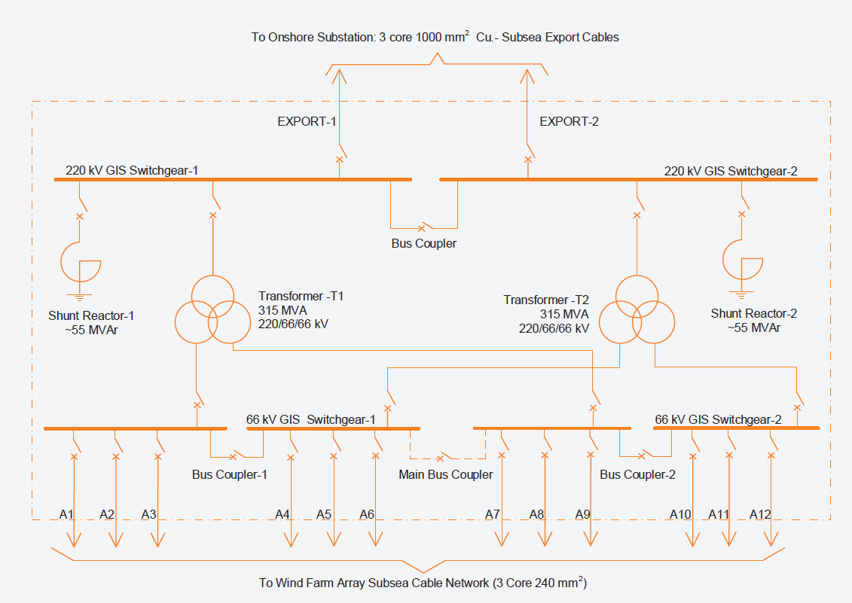
Electrical Study
Gujarat
Tamil Nadu
Distance from shore invokes the requirement of having an offshore substation which facilitates the transmission of 150 to 500 MW from the offshore windfarm to the shore at high voltage. 66 kV array cables are assumed for 6 MW and 10 MW turbines and 33 kV assumed for 4 MW turbines
Close proximity to shore is assumed to facilitate a direct HVAC connection of the offshore wind farm to the onshore substation. 66 kV collection system voltage level is assumed for all turbine MW capacities;

Slide 11
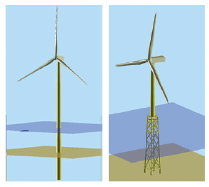
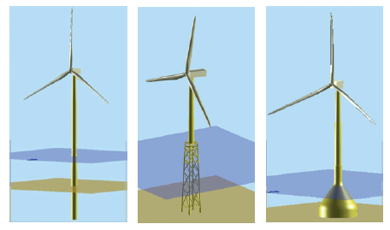
Foundation Study
Gujarat
Tamil Nadu
Either monopile and jacket foundations will be likely options to take forward to the next stage of investigation. If actual in-situ conditions align with the estimated upper bound soil profile parameters, monopiles could be favourable given the shallow water depths. Lower bound conditions very challenging for monopiles.
Either monopile or jacket foundations will be likely options to take forward to the next stage of investigation. Gravity-based Structure (GBS) foundations could be financially favourable but will be very site specific and dependent on the presence of highly competent soils. In terms of cost monopiles are more economical compared with jackets, however pile drivability is a risk.

Slide 12
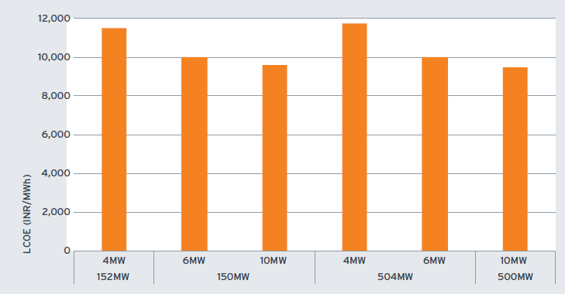
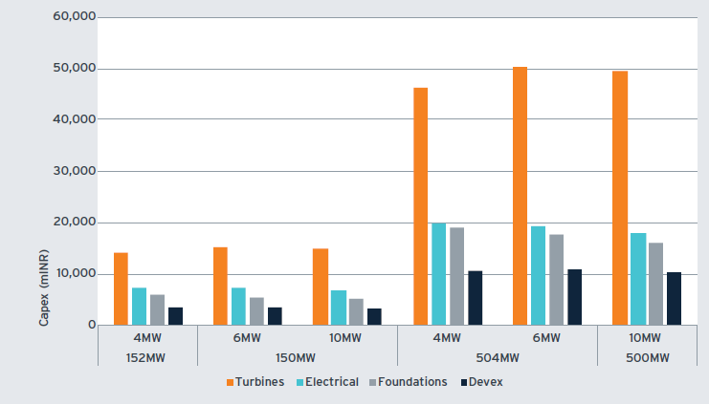
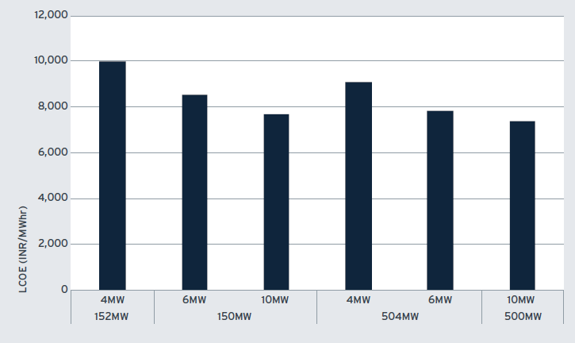
Cost of Energy Estimates
Gujarat & Tamil Nadu
Wind resource and the financial discount rate are the most significant factor affecting offshore wind Cost of Energy (COE). Increasing the capacity of the wind turbines from 4MW to 10MW results in a cost of energy reduction.
LCOE Gujarat
CAPEX Gujarat
LCOE Tamil Nadu

Slide 13
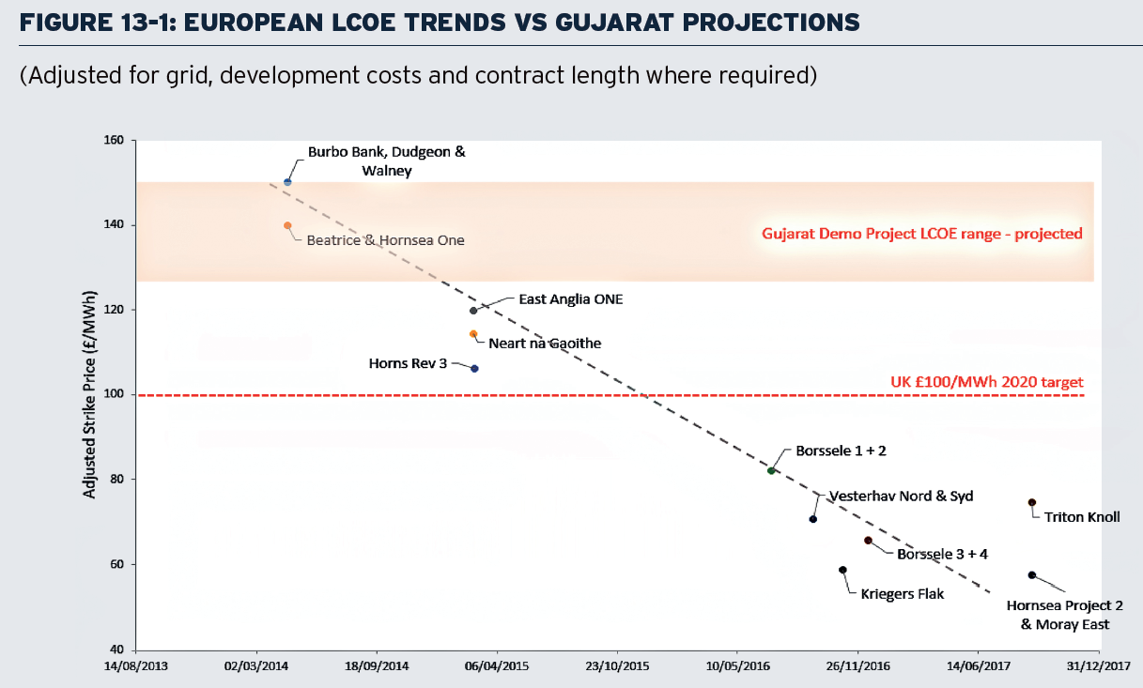
Cost of Energy Estimates
Gujarat LCOE comparison
9,752 INR/MWh to 11,515 INR/MWh for 150-152 MW
9,578 INR/MWh to 11,682 INR/MWh for 500-504 MW
Notes:
Figure compares recently awarded European offshore wind tenders against LCOE projections for the Gujarat demonstration project. It can be seen the projected LCOE in Gujarat is higher than in recent European bids, and this can be attributed to the low wind speed resources in Gujarat reducing AEP and the demonstration project status which requires a higher financial discount rate (i.e. 10% vs. 6-7%).

Slide 14
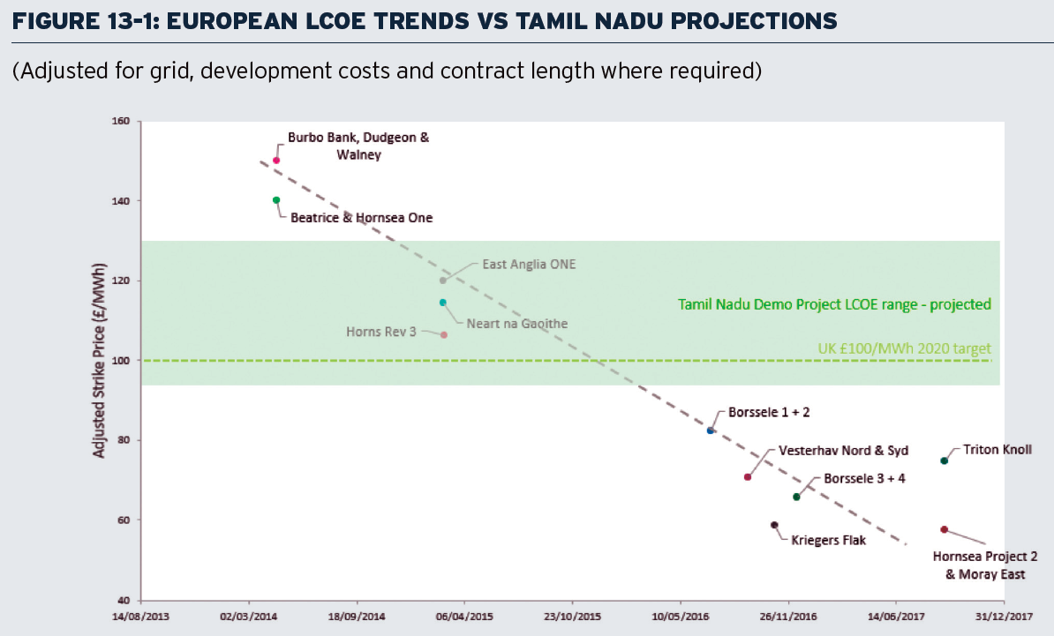
Cost of Energy Estimates
Tamil Nadu LCOE comparison
7,675 INR/MWh to 9,965 INR/MWh for 150-152 MW
7,362 INR/MWh to 9,087 INR/MWh for 500-504 MW
Notes:
Figure 13-1 compares recently awarded European offshore wind tenders against LCOE projections for the Tamil Nadu demonstration project. It can be seen the lower bound of the projected LCOE figures for Tamil Nadu is broadly in line with the UK 2020 target and the upper bound is slightly above but still tracking LCOE figures for recent European projects. This appears positive for Tamil Nadu, especially considering the demonstration project figures have be calculated based on a higher financial discount rate (i.e. 10% vs. 6-7%).

Slide 15
Concluding statements
Offshore Wind in India is commercially viable, subject to:
  Supportive policy and financial incentives
  Localisation of the supply chain
  Improvements in offshore wind speed measurements (e.g. from the Gujarat LiDAR)
  Risk management, supported by lessons learnt in overseas markets
FOWIND feasibility studies have provided outline wind farm concepts for 150 to 500 MW demonstration projects in Gujarat and Tamil Nadu
Providing companies and government institutions with a starting point for future detailed offshore Front End Engineering Design (FEED) studies and assistance with identifying key risks
KEY RISKS
Wind Resource: high uncertainty of the wind resource assessment (noted FOWIND LIDAR now installed and collecting valuable data in Gujarat);
Geotechnical Conditions: there is only limited information on the seabed geology of the Gujarat and Tamil Nadu regions available;
Grid Connection: grid availability.
Notes:
DNV GL’s experience in Gujarat indicates weak material in the top 20 to 40m, challenging the foundation techno-economic feasibility. Deep pile embedment required;
DNV GL’s experience in Tamil Nadu indicates high spatial variation from loose/weak to strong highly cemented sand material to depth;

Slide 16
  Q&A?
  Open Discussion

Slide 17
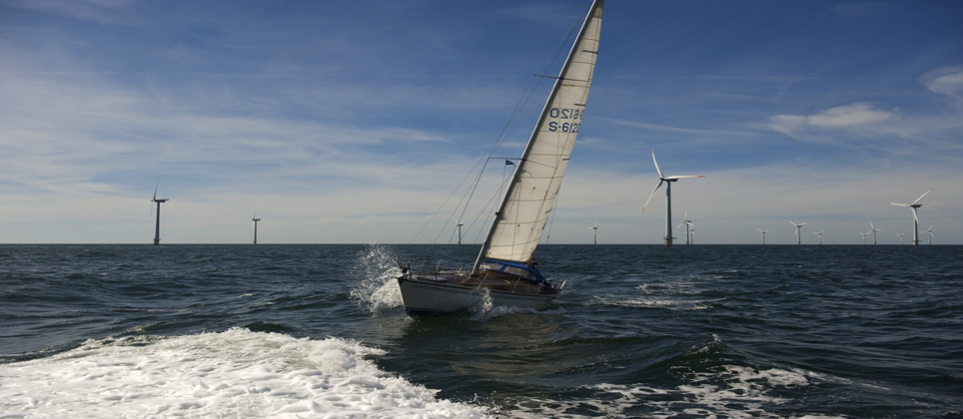
This project is co-funded by the European Union
For more information please contact:
FOWIND Project Management Unit, alok.kumar@dnvgl.com ; shruti.shukla@gwec.net

Slide 18
LCOE sensitivity to wind speed

Slide 19
LCOE sensitivity to discount rate
It is assumed that the discount rate r is stable during the project lifetime. FOWIND has assumed a 10% discount rate based on OECD’s guideline that a 10% discount rate “[corresponds] approximately to the market rate in deregulated or restructured markets”.
Demonstration project status hence requires a higher financial discount rate (i.e. 10% vs. 6-7%).

