Slide 1
FOWIND:
Supply Chain and Ports Report

Slide 2

SPEAKERS
Chris Garrett
Senior Offshore Wind Farm Engineer
DNV GL
Chris has over 9 years experience working specifically as an offshore wind installation and logistics Senior Engineer at DNV GL. This work has included feasibility studies, Front End Engineering Design (FEED), cost modelling, ports & logistics, fabrication, complex problem solving and acting as an offshore wind client representative for most of the key installation activities.
Chris has wide ranging and global offshore project experience, including the Southern North Sea, Irish Sea, Baltic Sea, US, China, Taiwan, Korea and India.
Previously he was involved in building piled-quaysides, jetties, Ro-Ro facilities, rock armour bunds for coastal and harbour-defences, and land-reclamation. Chris has also worked as a qualified welding inspector and specialist fabrication engineer.
He acts as a technical project advisor for FOWIND and is a co-author of both the Pre-Feasibility Reports and the Supply Chain, Port Infrastructure and Logistics Study.”
Email: Chris.garrett@dnvgl.com

Slide 3


Slide 4
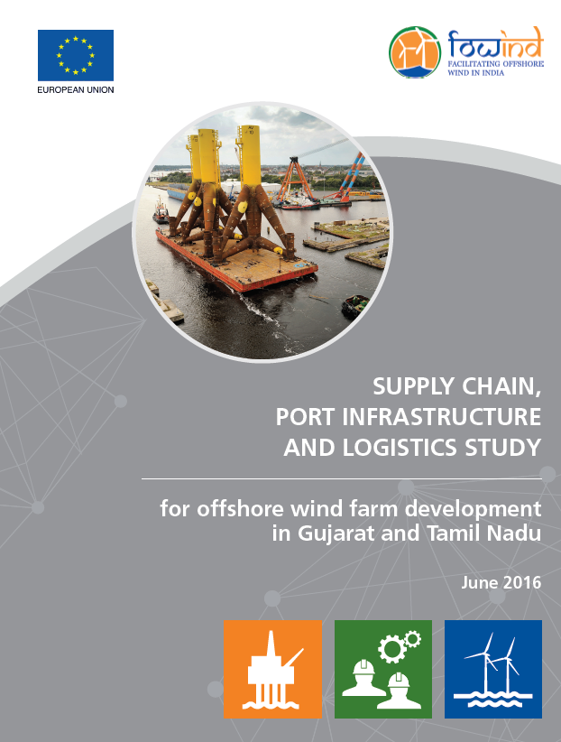
Supply Chain, Port Infrastructure and Logistics Study - Introduction
Objective:
“develop further understanding of typical ports, vessels, infrastructure and supply chain requirements for offshore wind project development”
Notes:
Specifically the report delivers:
→ an overview of key supply chain elements required for offshore wind;
→ a high-level appraisal regarding the feasibility of local supply for key components in the medium and long term;
→ an overview of key infrastructure and logistical requirements for an offshore wind project during development, fabrication, transportation, installation, operations and maintenance and decommissioning;
→ an appraisal of suitability and readiness of India’s existing port infrastructure for offshore wind development.
The supply chain assessment identifies the extensive procurement list that would be required to develop a typical offshore wind farm. The specific supply chain requirements and considerations for major offshore wind project phases/packages (e.g. development, turbines, support structures, electrical elements, construction and O&M) are
further defined. The remainder of the assessment focuses on identifying key global players and providing a
commentary on current and potential Indian suppliers that might have capability to enter the local market. Given the relative immaturity of the Indian market and the supply chain the local assessment is conducted at high-level and would need to be re-visited when specific projects are identified.
The port infrastructure and logistics assessment commences with an initial preparation phase where; estimated Indian project specifications (from the FOWIND Pre-feasibility reports), component specifications, vessel requirements and possible installation strategies are defined. Following this initial preparation phase the port screening phase is executed, which provides a desk-based study, considering the suitability of offshore wind ports in Gujarat and Tamil Nadu to supply the potential offshore wind project demand for construction and O&M operations. The final stage provides a more detailed port readiness assessment which includes reports from site visits conducted at the most promising ports.

Slide 5
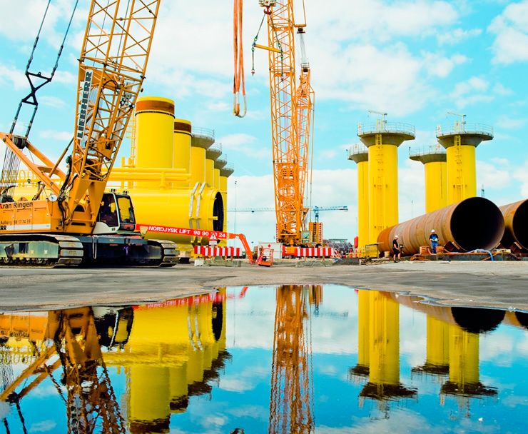
Port Infrastructure in Gujarat and Tamil Nadu
Notes:
Classic photo of a monopile marshalling. Monopiles unpainted, laying down. Painted transition pieces with secondary steelwork standing upright.
Monopile transportation by SPMT, transition piece transportation by heavy crawler crane, “pick and carry”.

Slide 6
Offshore wind ports
Five main types of offshore wind ports – specifically for:
Wind turbine generator (WTG) manufacturing;
WTG foundation (FND) manufacturing;
Offshore substation (OSS) manufacturing;
Operation and maintenance ((O&M);
Marshalling (MAR).
Notes:
In this report we have adopted a “functional” port classification system.
WTG encompasses nacelles, blades, towers-ideally co-located.
WTG foundation-Mono piles, jackets, gravity base structure GBS.
Offshore substation (mainly topside), and
marshalling of the above components.
Above will be permanent facilities – with long duration activity at the site – marshalling – transient activity during construction phase only
Operation and maintenance, lighter duty infrastructure, vital to be geographically close to OWF
It should be noted that an individual port estate may have the capability to handle more than one or even all of the above port operations.
Nevertheless different operations and components have different handling and storage requirements and as such ports must be considered on a case by case basis.

Slide 7
Artist’s impression of Siemens WTG Manufacturing Base – Hull, UK
Notes:
Long manufacturing buildings for turbine blades, and towers, nacelles final assembly requires more rectangular or square heavy duty workshops. Heavy duty quaysides with large storage areas, suitable for WTI Vs to Jack up alongside, and load out components.

Slide 8
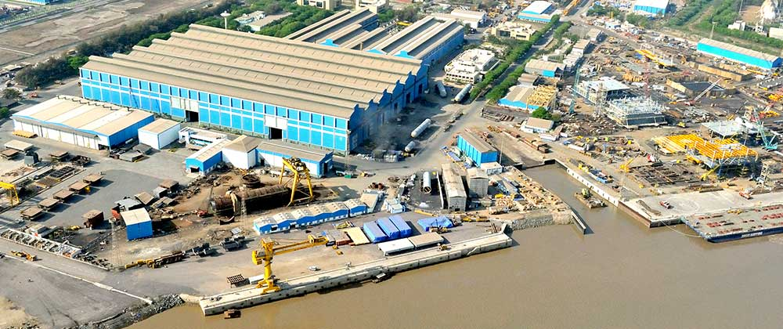
Foundation Manufacturing Facility – Larsen & Toubro, Hazira
Notes:
Monopiles require long low headroom workshops, with rails in the floor. Jackets’ final assembly requires high headroom workshops with approximately 100 m length, as do blast and paint shop(if these activities are carried out inside).
Materials in tends to be delivery by cargo vessels. Foundations ALWAYS leave via water-borne craft.
Load-out tends to be onto heavy lift cargo vessels (own cranes) or barges (needs onshore craneage), and quaysides needed to accommodate these vessel types.

Slide 9
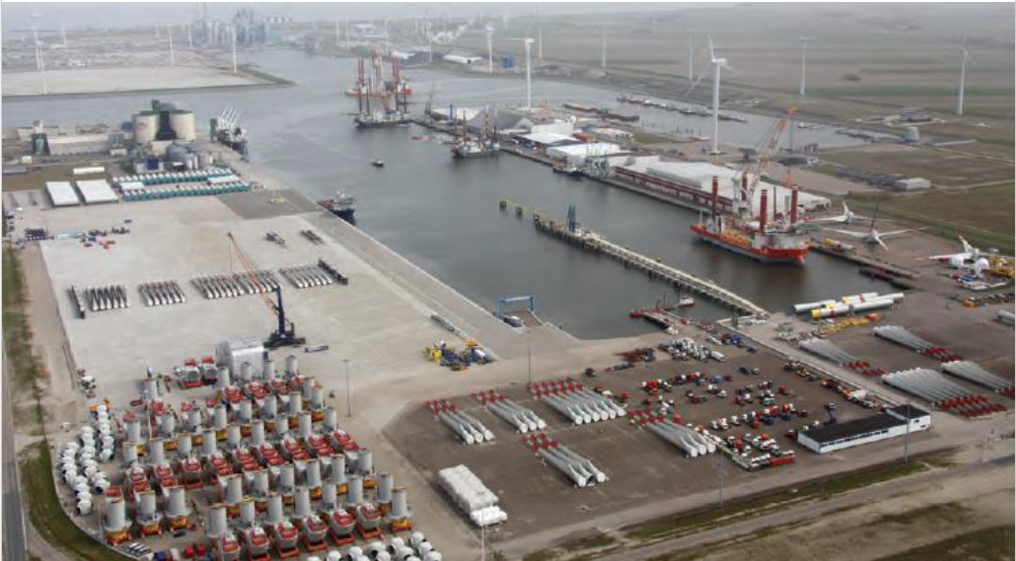
Marshalling WTGs for Borkum West II (ph1=40 x 5MW), Eemshaven
(12 month delay in provision of German offshore HVDC grid = 40 WTGs in storage )
Rotor Assembly
Towers
WTIV Loadout
Blades
Blades
Hubs
Blades
Nacelle Storage
Notes:
We previously saying monopole marshalling. Turbine marshalling requires vast areas potentially with pre-assembly of rotor stars for some turbine models.

Slide 10
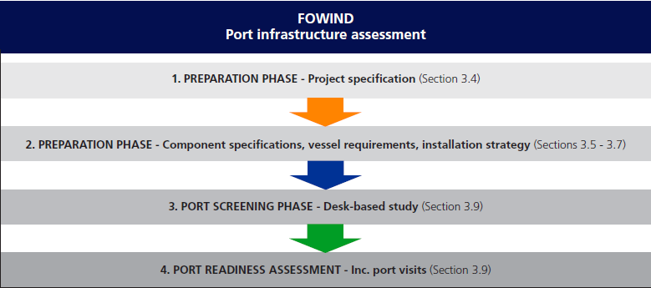
Port Infrastructure assessment methodology (Section 3.3 onward)
LANDWARD LIMITATIONS – Dictated by Foundation, OSS & WTG Components
SEAWARD LIMITATIONS - Dictated by Vessel Dimensions needed for Installation Strategy
Notes:
The assessment methodology-
Project characteristics e.g. megawatt overall capacity, range of turbines under consideration (megawatts), foundations (Mono piles, jackets, GBS), water depth range, distance to major port infrastructure, distance to electrical grid, met ocean climate, scour issues.
Component sizes drive “landward” port infrastructure demands-turbine and foundation component weights and sizes, bearing pressures alongside quayside, haul route, storage.
Installation strategy selection, drives vessel selection, and therefore “seaward” port demands-n.b. many installation strategy options for how any combination of turbine and foundation is installed – port infrastructure availability may drive installation strategy/vessel selection.
Tabulate landward and seaward demands of each installation strategy.
Establish the capacity of all suitable berths in all adjacent ports.
Supply and demand… compare…
- “demands” made upon ports by landward and seaward implications of each installation strategy, turbine, foundation triplet, with - supply of berths suitable to meet those demands.
Shortlist best ports, and arrange visits

Slide 11
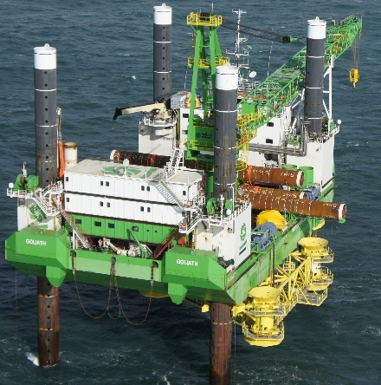
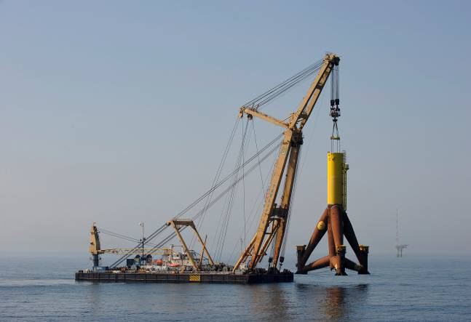
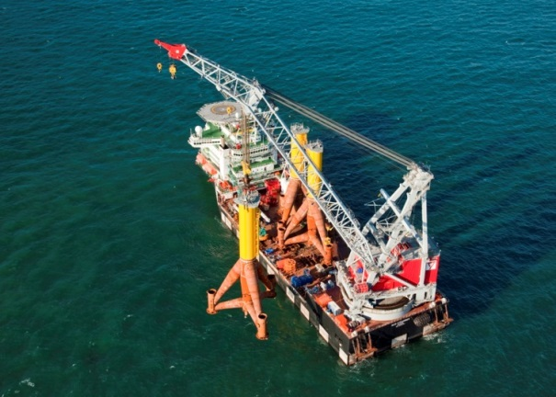
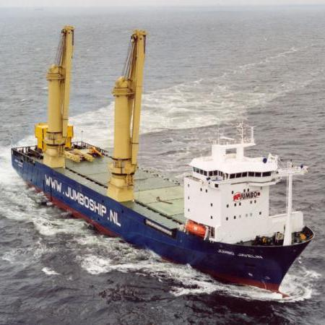
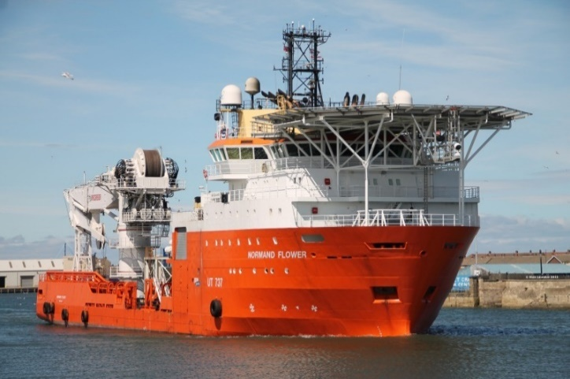
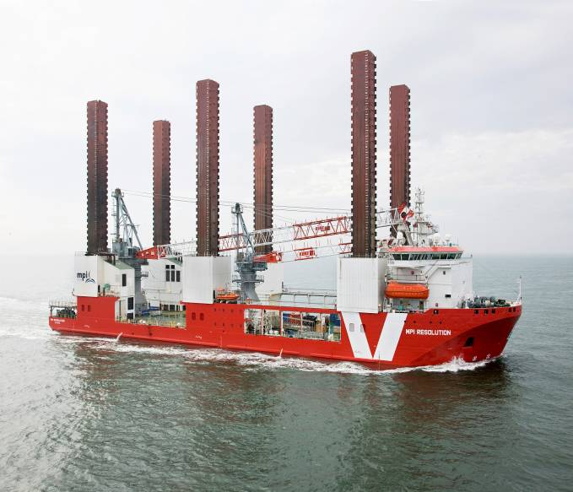
Selecting the right vessel & tools for the job! More later……
Small JUB
Shearleg crane SLHLV
Heavy-lift vessel HLV
Heavy-Lift Cargo Vessel HLCV
Offshore Supply Vessel OSV
Wind Turbine Installation Vessel WTIV
Goliath 2) Taklift 7 3) Oleg Strashnov
4) Jumbo Javelin 5) Normand Flower 6) MPI Resolution
Notes:
A number of generic vessels were selected, and there dimensions used as representative of each vessel class, to assess the water depth and beam requirements.

Slide 12
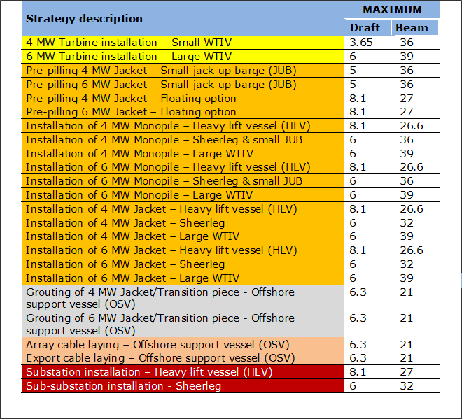
Water Depth & Width requirements of Vessels by T&I Strategy
Notes:
Each installation strategy option required certain generic vessels.
The maximum beam and draft of the largest vessel needed for each installation strategy was tabulated.

Slide 13
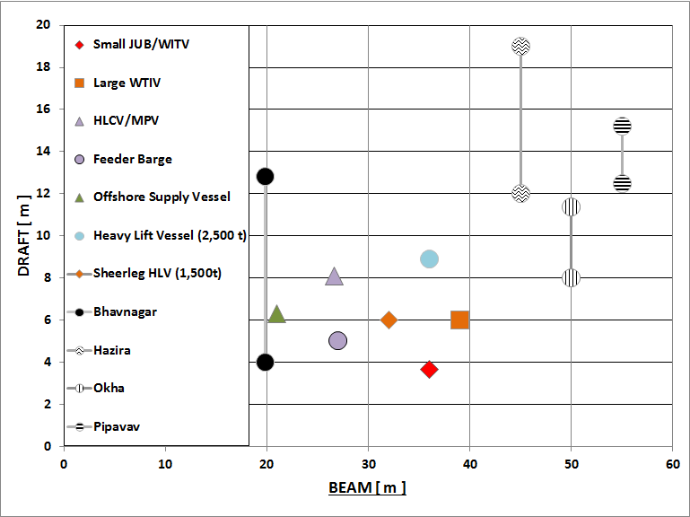
DNV GL “Vessel Port Access Requirements”, VPAR Gujarat
Un-restricted
Notes:
VPAR – Will the vessel fit in the port ? If Port is higher, and to the right of vessel – YES !
A similar assessment procedure was adopted to screen whether particular berths in particular ports have the landward capability to accommodate the requirements of individual installation strategies.

Slide 14
DNV GL “Vessel Port Access Requirements”, VPAR Tamil Nadu
Un-restricted

Slide 15
Shortlisted Ports and Potential Development Zones in Gujarat
Notes:
After assessing their landward & seaward capabilities the above ports were selected to fulfil various roles for particular development zones A to H as defined in the following slide.

Slide 16
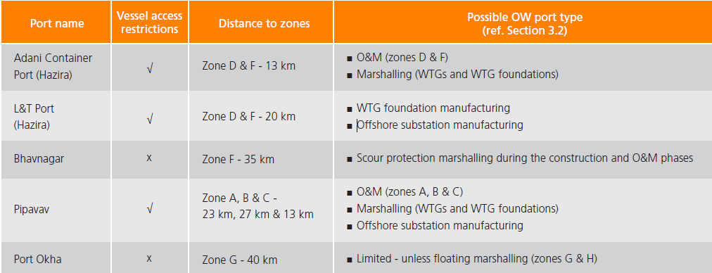
Port Infrastructure –
Gujarat construction port readiness assessment
Adani container port facility in Hazira –The water depths at this port are suitable for conventional or heavy-lift cargo vessels and has potential to be used as a wind turbine marshalling facility during construction.
Bhavangar port – It has a narrow lock-gate on the approach channel so is unsuitable for installation vessels. Existing rock-handling would allow usage as a centre for handling scour protection.
Larsen and Toubro’s fabrication facility in Hazira –It would be a possible fabrication site for several types of offshore wind foundations and possibly substation topsides)
Port of Pipavav (APM terminals) – The all-weather port is the largest on the west side of the Gulf of Khumbat. The port has potential to accommodate foundation and wind turbine marshalling facilities during construction and possibly offshore substation fabrication. Avoidance of coal dust may be required.

Slide 17
Shortlisted Ports and Potential Development Zones in Tamil Nadu

Slide 18
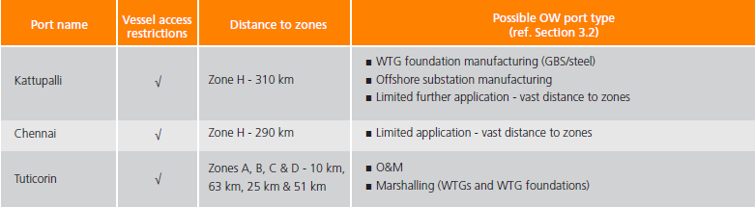
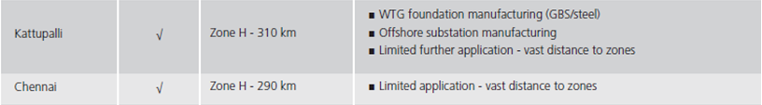
Port Infrastructure – Tamil Nadu construction port readiness assessment
Tuticorin - The port of Tuticorin is provided with general-break-bulk, and dry-bulk cargo handling facilities, and large high & heavy storage in the container terminal. Closest development zone is A, which is approximately 20 km. The port is ideally situated and has potential to be used as a wind turbine and foundation marshalling facility during construction.
Kattupalli - This deep water port is provided with a 20,000t ship-lift, an oil & gas jacket fabrication facility and a vast hinterland for storagee. Closest development zone is H, which is approximately 310 km. It has potential as a manufacturing site, most notably for GBS structures, jacket foundations and offshore substation topsides, and foundations.
Chennai - The deep water port of Chennai is provided with capability for handling wind turbines delivered by Heavy Lift Cargo Vessels. Closest development zone is H, which is approximately 290 km. Given this vast distance, and the fact that there is iron-ore handled which can cause problems with machined-surfaces, it is unlikely the port will play a significant role unless a cost effective solution is found.

Slide 19
Port infrastructure – Summary
The report provides extensive details and commentary regarding typical offshore wind component specifications, the range and suitability of construction vessels, different installation strategies and explanations for the suitability of common port infrastructure for offshore wind.
Following the port readiness assessments it can be concluded that no single port estate in India is currently suitable to facilitate all offshore wind construction activities without some level of adaptation or with the strategic use of multiple port estates.
Early consultations should be made, during the development process, with port authorities to establish any current and future conflicts of interest with regards to spatial planning and their appetite to facilitate offshore wind.
Gujarat – the most promising port estates appear to be Hazira (marshalling, manufacturing and O&M) and Pipavav (marshalling, OSS manufacturing and O&M).
Tamil Nadu – the most promising port estate in close proximity to the proposed development zones appears to be Tuticorin (marshalling and O&M), with manufacturing if current extension plans go ahead. Kattupalli could have some potential for foundation and offshore substation manufacture, but is at a significant from the most favoured development zones.
.

Slide 20
Chris Garrett
Chris.Garrett@dnvgl.com

