Slide 1
PROJECT GRANTED UNDER INDO-EUROPEAN COOPERATION ON RENEWABLE ENERGY

Slide 2
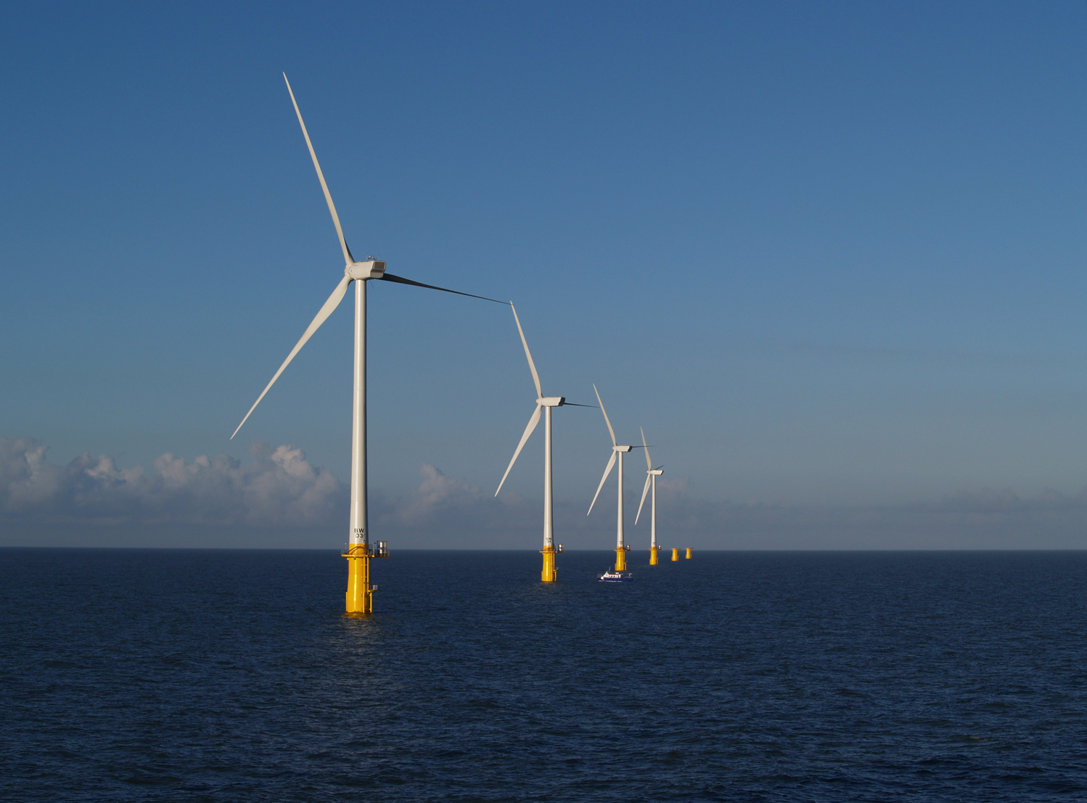
FOWIND : PROGRESS OVERVIEW
By Shruti Shukla,
Director – Policy and Projects, Global Wind Energy Council
(8th March 2018)

Slide 3




Background
Supported through a grant of EUR 4 million from the European Union Delegation to India and IMPLEMENTED in close cooperation with the Ministry of New and Renewable Energy by :
  Global Wind Energy Council (GWEC) led consortium that includes :
    DNV GL (Technical Lead)
    World Institute of Sustainable Energy
    CSTEP
  Also co-funded by
    Gujarat Power Corporation Limited [GPCL]
    Knowledge Partner
    National Institute of Wind Energy [NIWE]
    Industry Partner
    ReNew Power Ventures Private Limited
  Implementation period : Total of 51 months (13 December 2013 to 12 March 2018)

Slide 4
FOWIND
  Goal: Promote offshore wind power to facilitate India’s transition towards a low carbon energy future
  Key Objectives:
  Undertake preliminary feasibility studies for potential offshore wind development zone(s).
  Resource mapping (mesoscale) and validation (site specific), policy guidance and capacity-building.
  Build partnerships with the Government (State and Centre), Industry and R&D institutes.
  Develop an offshore wind development outlook for India (up to 2032)

Slide 5
Summary : Annual Activity
Year 1
Inception report : to establish baseline conditions
OW Policy and Market Assessment report published
Pre-feasibility assessment for offshore wind in Gujarat and Tamil Nadu published
Field visit and study tour to Germany
Stakeholder workshops
Year 3
Supply Chain, Port Infrastructure and Logistics Study for Offshore Wind Development in GUJ and TN published
Engineer’s training workshops for Gujarat and Tamil Nadu (with state utilities)
India’s 1st offshore LiDAR procurement conducted
Offshore Wind Grid Integration Study conducted
Completed
Completed
Year 2
Basic framework assessment (GUJ and TN)
  Ports study
  Infrastructure (supply chain etc.) study
Initiate EU-India R&D platform initiated on offshore wind in cooperation with NIWE
Supply Chain, Port Infrastructure and Logistics Study assessment conducted for Gujarat and Tamil Nadu
Year 4 /5
Published the Grid Integration Report
India’s 1st Offshore LiDAR deployed (Gujarat)
Published Offshore Wind Outlook 2032
Stakeholder conclave (Welcome!)
Feasibility analysis for an Offshore wind farm in Gujarat and Tamil Nadu
Completed
Completed

Slide 6


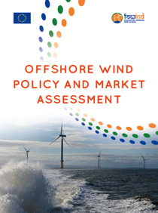
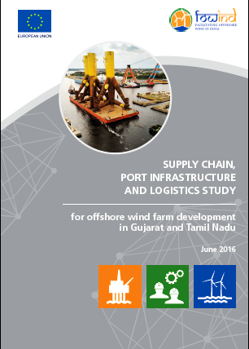
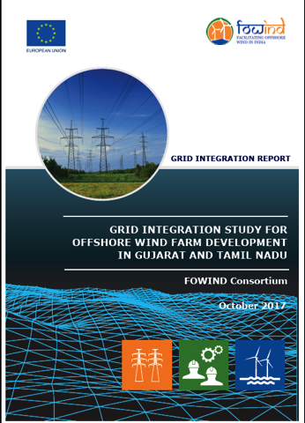
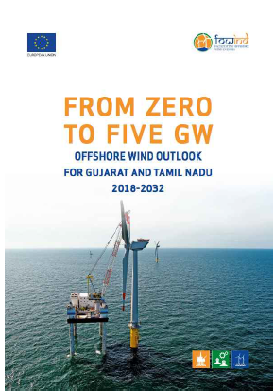
All reports are available for download from : www.fowind.in

Slide 7
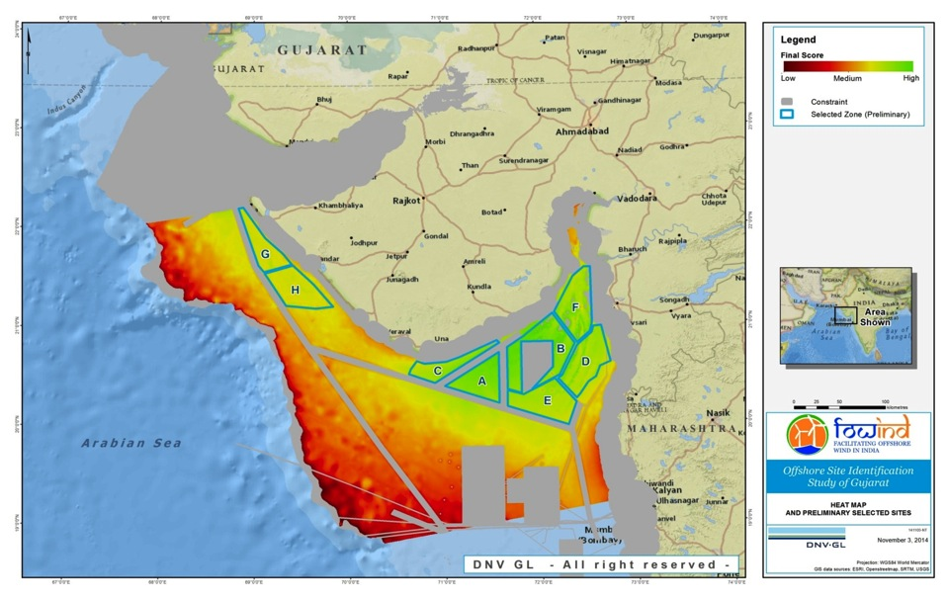
Gujarat: Potential development zones
FOWIND Feasibility Assessments in Zone A - Gulf of Khambhat
FOWPI’s work is foccussed on Zone B

Slide 8
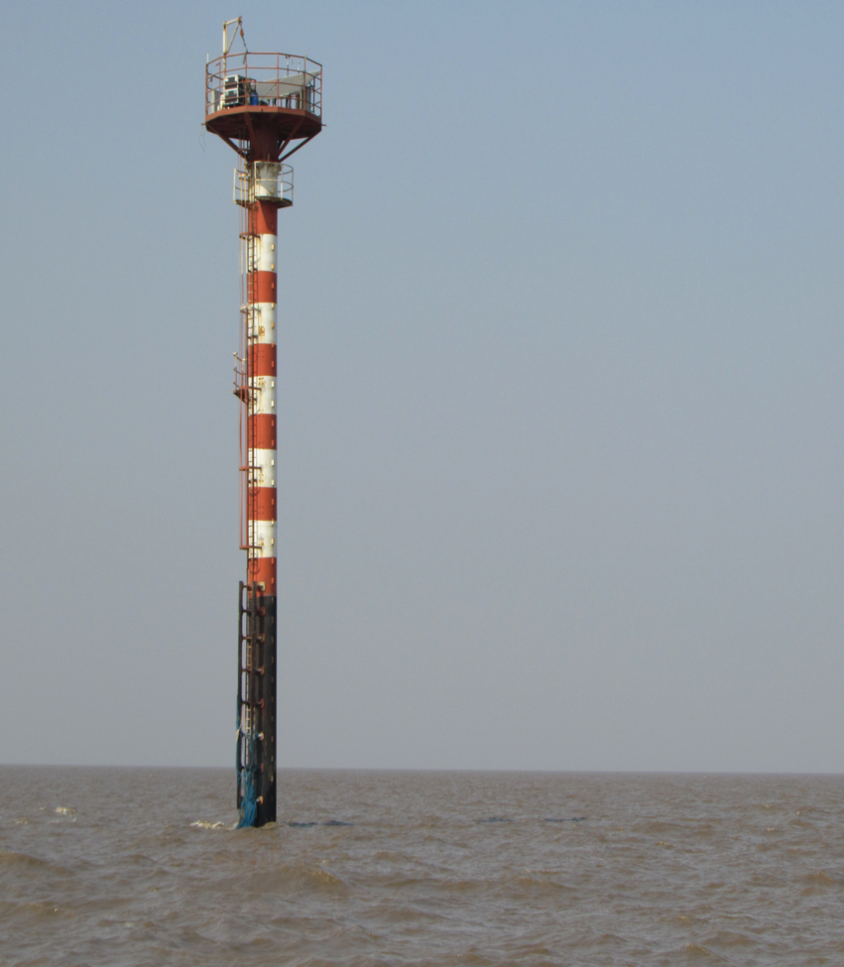
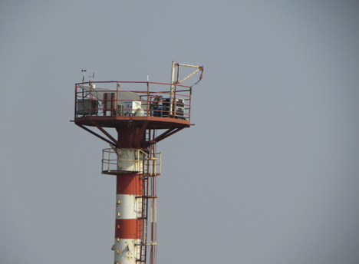
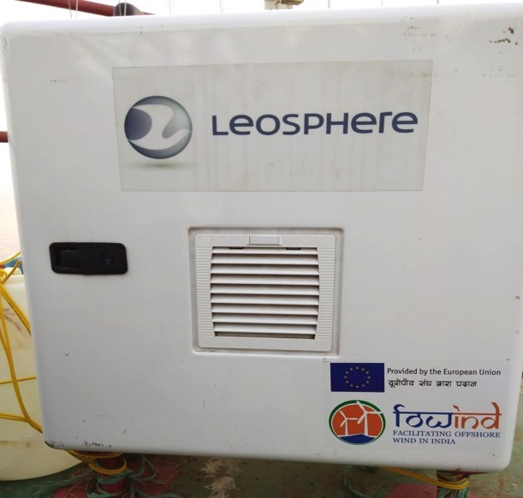
Gujarat: First Offshore Lidar Installation
FOWIND worked with NIWE, the MNRE and NIOT to commission the LiDAR unit (Leosphere’s WindCube V2) in the Gulf of Khambhat on 2nd Nov 2017.
Meteopole won the FOWIND supply tender and provided technical assistance during commissioning.
GPCL and GMB provided support with NOCs.

Slide 9
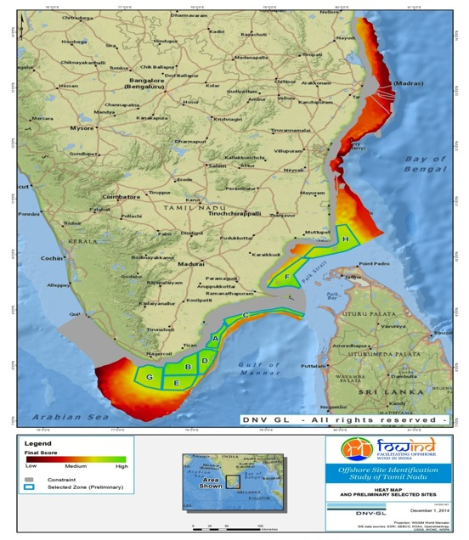
Tamil Nadu: Potential development zones
FOWIND feasibility assessment focused on Zone A - Gulf of Mannar

Slide 10
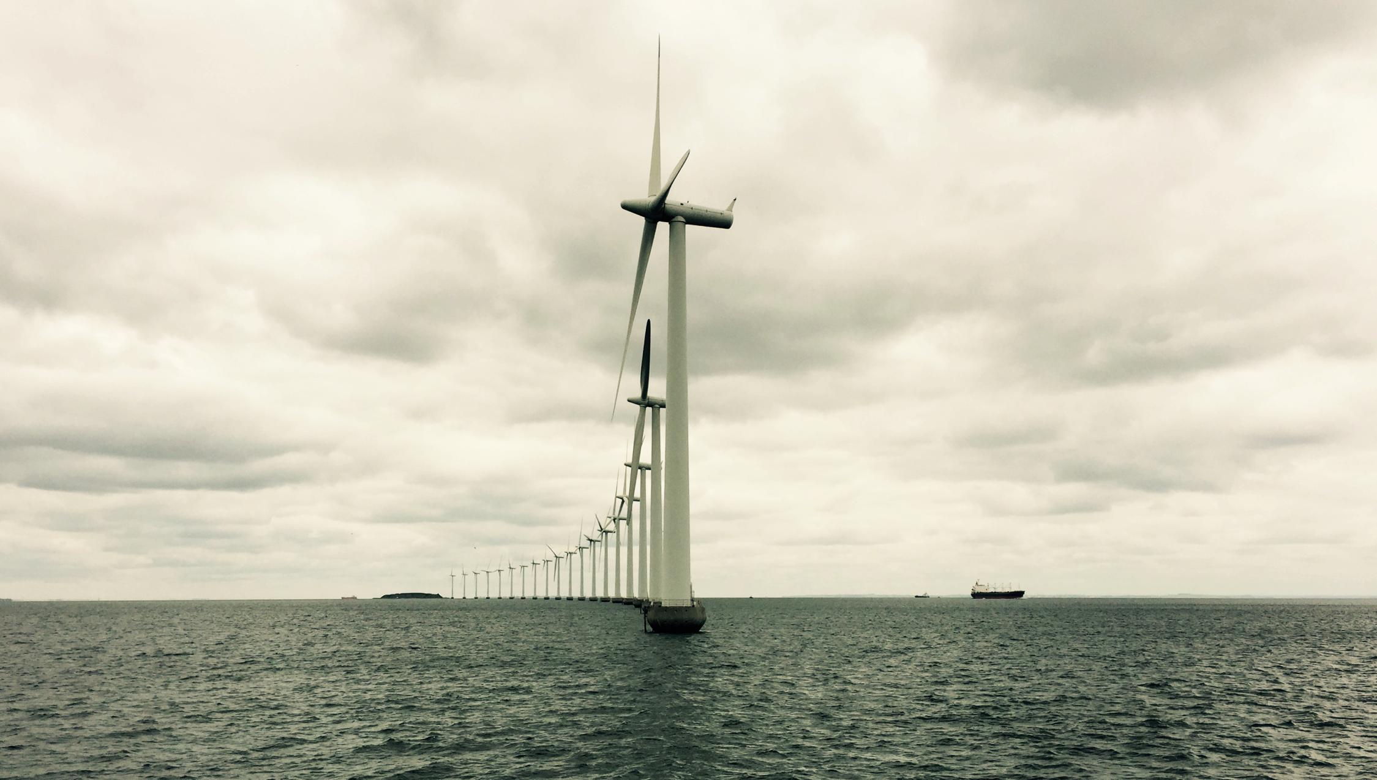

This project is co-funded by the European Union
For more information please contact the Global Wind Energy Council
Steve Sawyer Steve.sawyer@gwec.net ; and Shruti Shukla shruti.shukla@gwec.net

